Slide 1
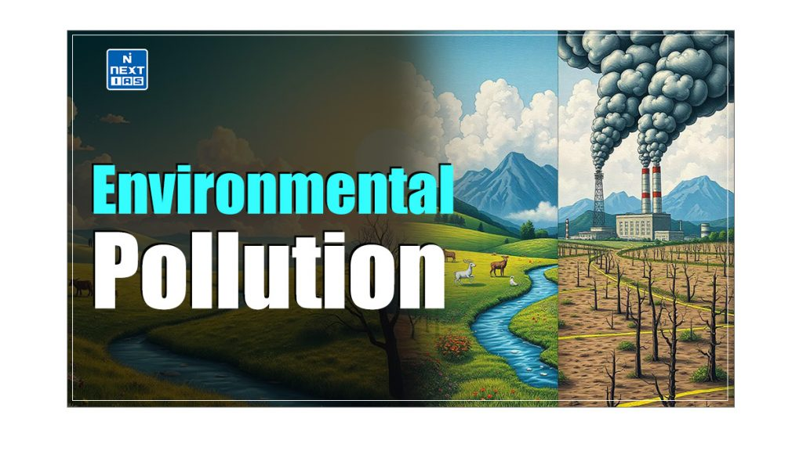


Slide 2
Introduction
Environmental Pollution has emerged as one of the most pressing challenges of the 21st century. The issue has led to threats to human health, ecosystems, and the overall well-being of our planet. This article aims to study in detail Environmental Pollution, its meaning, types, causes, consequences, and related concepts such as pollutants & their types.
What is Environmental Pollution?
Environmental Pollution refers to the introduction of harmful materials into the environment.
In other words, environmental pollution is the contamination of the physical and biological components of the environment to such an extent that normal environmental processes are adversely affected.
Pollutants
Any harmful material that, by getting introduced into the environment, causes environmental pollution is called a pollutant.
In other words, a pollutant is any substance that contaminates air, water, soil, etc, and damages their quality.
Pollutants can be natural, such as volcanic ash, or created by human activity, such as trash or factory runoff.

Slide 3
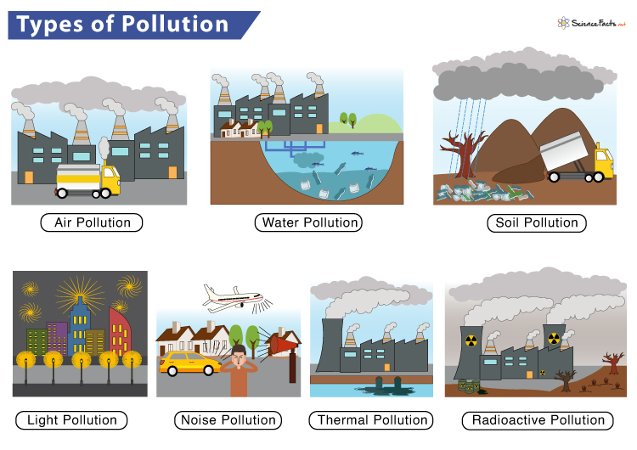
Types of Pollution

Slide 4
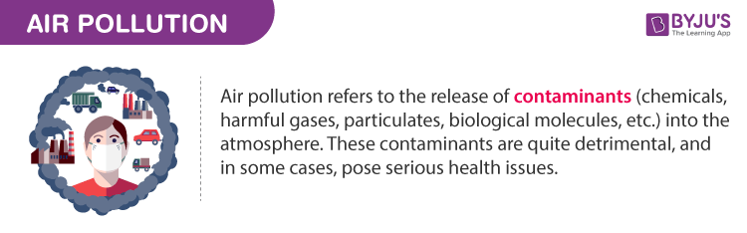
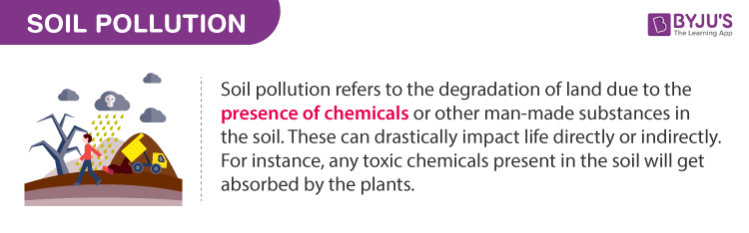
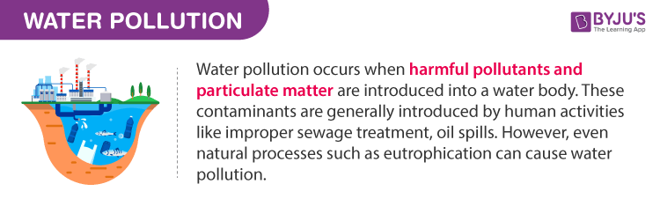


Slide 5
Consequences of Environmental Pollution
Public Health
Pollution is a significant cause of diseases and premature deaths globally.
Different types of pollution have different impacts on human health.
Air pollution alone is responsible for millions of deaths annually, with children and the elderly being particularly vulnerable.
Environmental Degradation
Pollution disrupts ecosystems, leading to the loss of biodiversity, degradation of natural habitats, and alteration of ecological processes.
All these, in turn, lead to issues such as disruption of food chains and environmental pollution.
Climate Change
Pollution, particularly from greenhouse gas emissions, is a significant driver of climate change.
This, in turn, leads to issues such as global warming, more frequent and severe weather events, rising sea levels, and shifts in ecosystems.
Economic Costs
The economic burden of pollution is immense, including loss of productivity and ecosystem damage.
The expenses on environmental pollution control measures and increased healthcare costs also add to the economic costs of pollution.
Social Impacts
Pollution can reduce overall quality of life by affecting people’s health, well-being, and enjoyment of their environment.
Environmental degradation and its associated consequences, such as droughts, water crises, etc, can cause social unrest and conflicts, forced displacement of communities, etc.

Slide 6
Suggested Measures for Addressing Environmental Pollution
Policy and Regulation: Governments must implement strict environmental regulations to limit emissions, control waste, and promote sustainable practices.
Public Awareness and Education: It is crucial to tackle pollution by educating the public about the causes and consequences of pollution and encouraging environmentally responsible behaviour.
Sustainable Practices: Promoting sustainable consumption patterns and resource management.
The principles of the circular economy, which emphasise recycling and reusing resources, should be widely adopted.
Technological Solutions: Innovations in clean energy, waste management, and pollution control technologies can significantly reduce human activities’ environmental footprint.
International Cooperation: Environmental pollution is a transboundary issue that requires coordinated international efforts.
Through treaties, conventions, and collaborative initiatives, global cooperation is essential for addressing environmental pollution globally.

Slide 7
Conclusion
Environmental pollution poses a significant threat to the health of our planet and its inhabitants. As a challenge transcending national boundaries, it requires a collective effort from governments, industries, and individuals to implement sustainable solutions. By adopting a holistic approach and taking immediate action, we can protect our planet for future generations and ensure a sustainable future.

